Slide 1
PERFECT COMPETITION
Dr. Napinder Kaur
Assistant Professor

Slide 2
LEARNING OUTCOMES
After the lecture, you will be able to
Examine the nature of a perfectly competitive market.
Analyze the short-run equilibrium analysis.

Slide 3
DEMAND AND REVEUNE OF FIRM
MR = dTR/dQ
MR = dPQ/dQ
MR = Q.dP/dQ + P. dQ/dP
MR = P
AR=MR=P

Slide 4
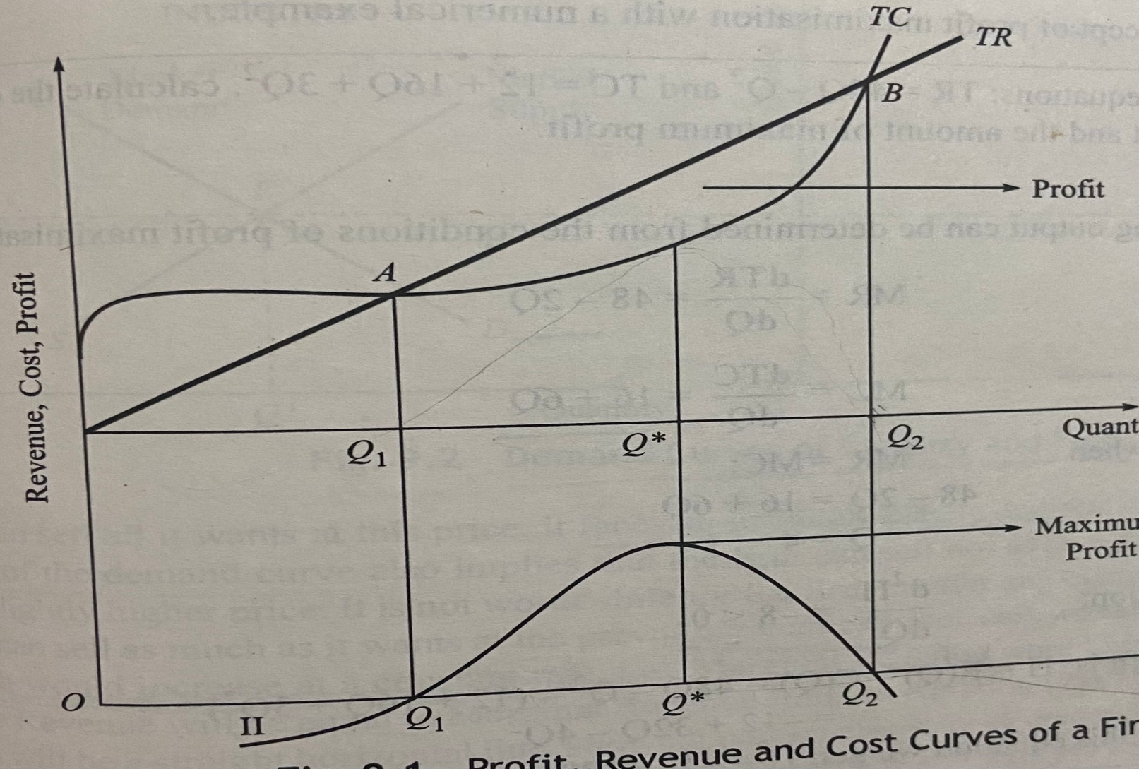
COST, REVEUNE AND PROFITS

Slide 5
ANALYTICAL CORNER
Given the following equations:
TR = 48Q – Q^2
TC = 12 + 16Q +3Q^2
Calculate the output that maximizes profit and amount of maximum profit.

Slide 6
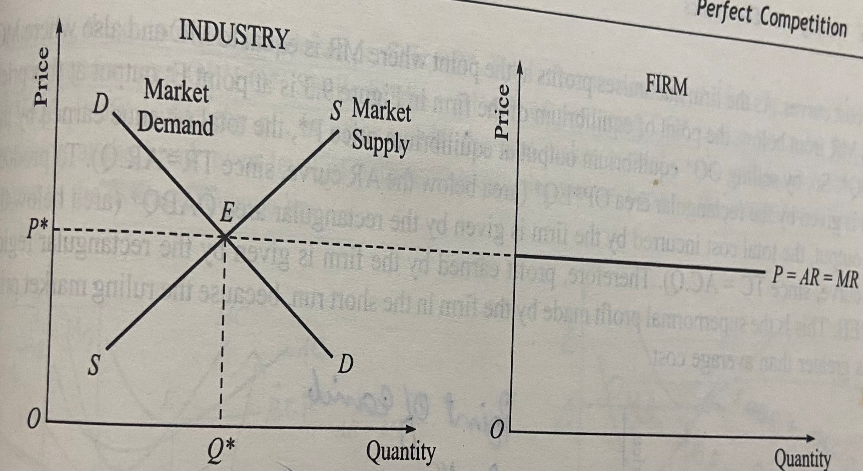
MARKET DEMAND CURVE AND FIRM’S DEMAND CURVE

Slide 7
SHORT RUN EQUILIBRIUM
Supernormal profits
Normal profits
Loss

Slide 8
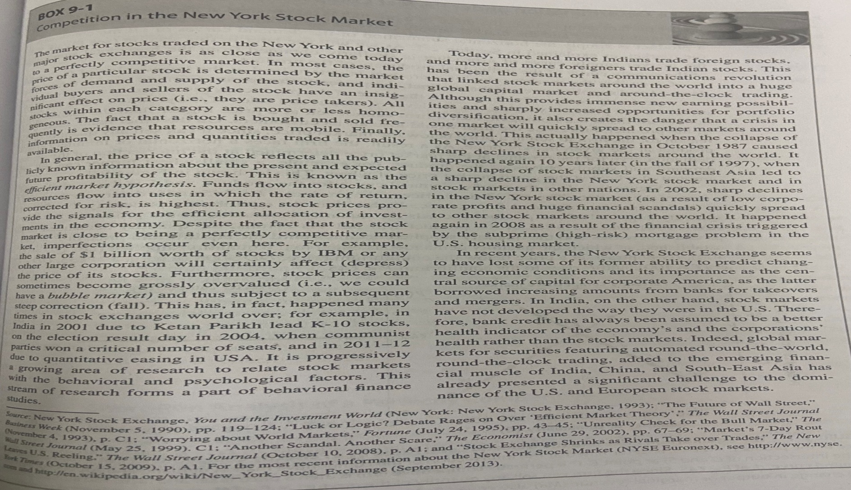
CASE ANALYSIS

Slide 9
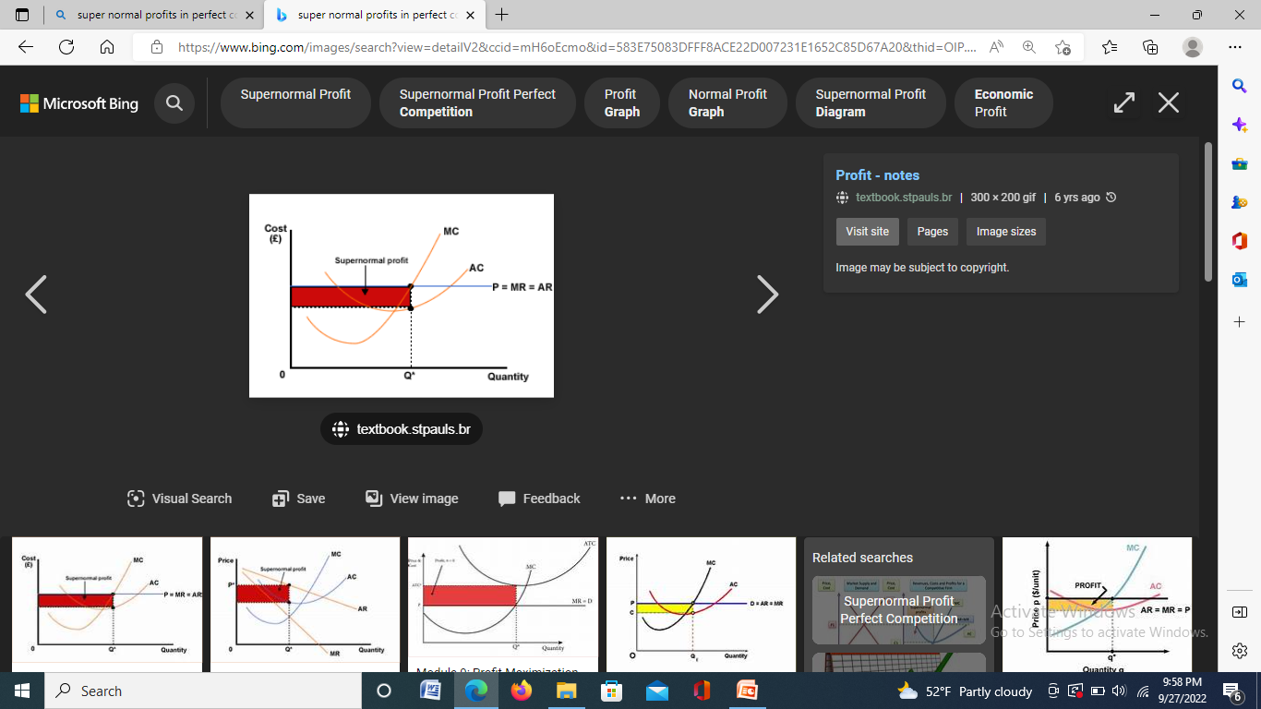
SUPER NORMAL PROFITS

Slide 10
ANALYTICAL CORNER
Total cost function of a competitive firm selling its product at Rs. 640 per unit is
TC = 240Q – 20Q^2 + Q^3. Find the profit maximizing output and the value of maximum profit.

Slide 11
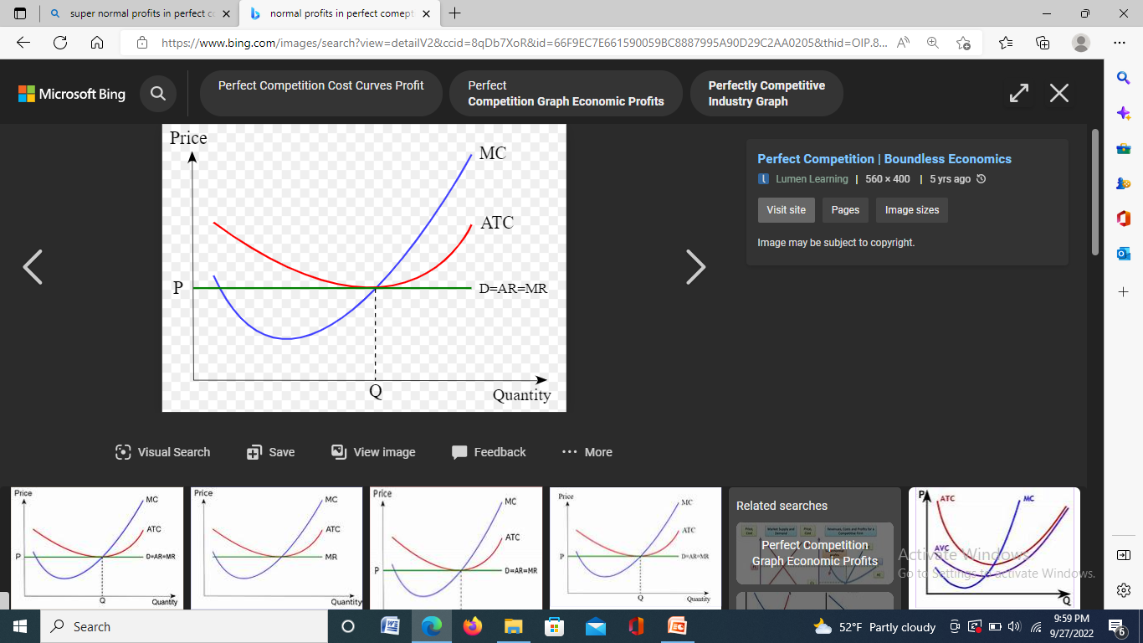
NORMAL PROFITS

Slide 12
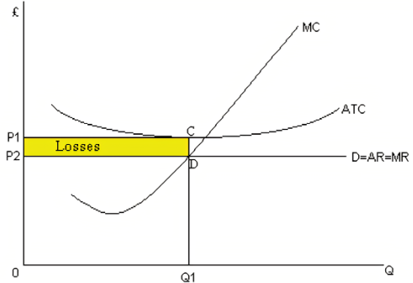
LOSS

Slide 13
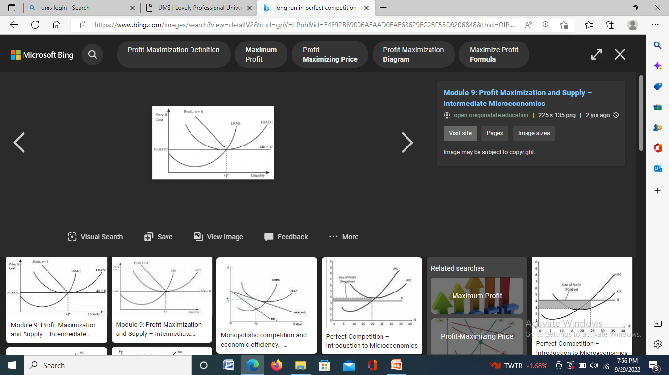
LONG RUN ANALYSIS

Slide 14
CASE ANALYSIS
Market competition and Internet

